Slide 1
Machine Learning with Python
Python Overview
and
Installing Python

Slide 2
Python overview
Developed by Guido Van Rossum in 1991 it has quickly become one of the most popular programming languages in the world.

Slide 3
Python overview
Python has many advantages
Developers can learn it quickly
Typically involves less code
Syntax is easier to read
Utilized by every major technology company
Huge amount of additional open-source libraries.

Slide 4
What can you do with Python?

Slide 5
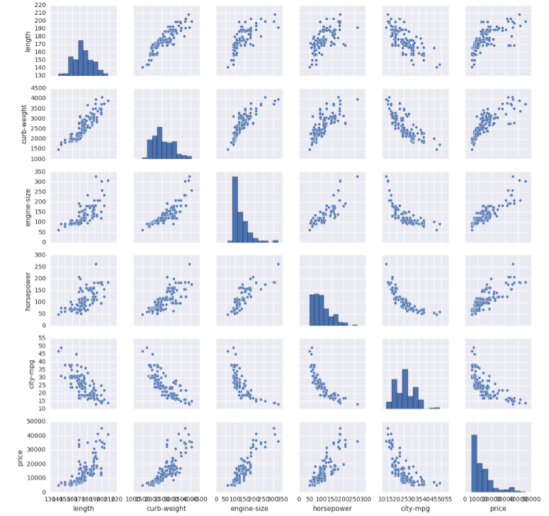
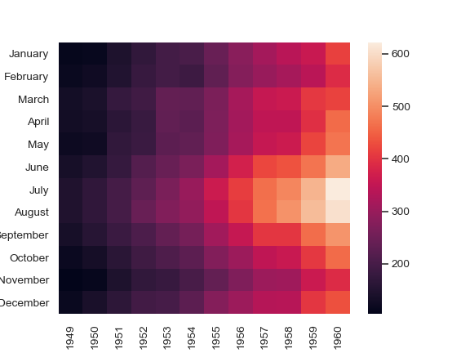
Data Analysis

Slide 6
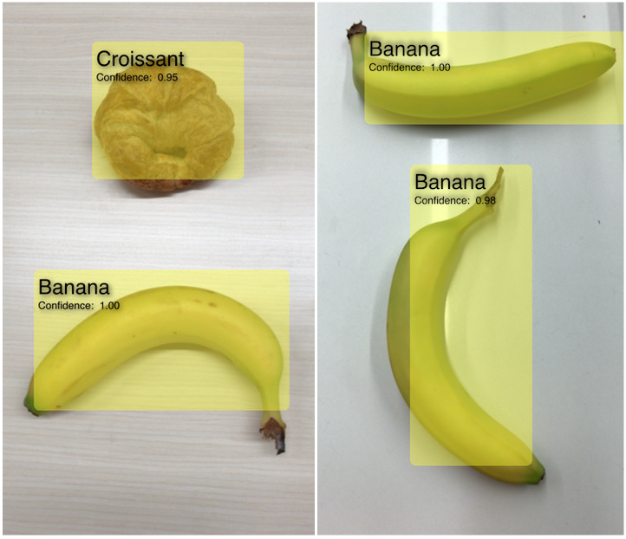
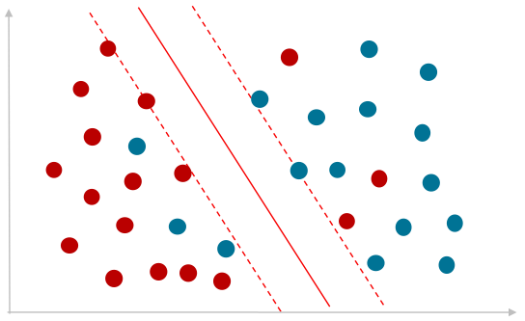
Machine Learning

Slide 7

API
You can call services like weather services programmatically with parameters: example
http://api.openweathermap.org/data/2.5/weather?q=Milan&APPID=7dd254530854a6014e19513d72365351

Slide 8
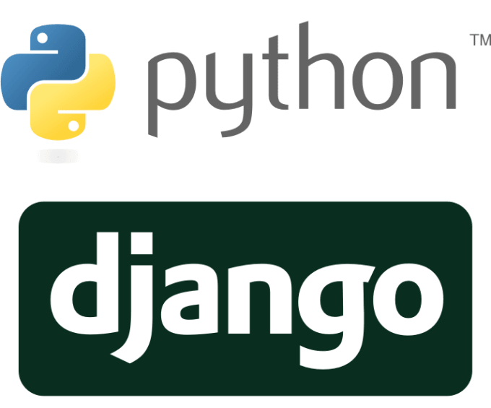
Website development
You can build Web App with Django!

Slide 9


Scrapers
Launch the Scraper Example!
COURSE UDEMY

Slide 10

Much more… Astropy

Slide 11
Scraping
Demonstration

Slide 12
Python overview
To install Python we will use the free Anaconda distribution.
This distribution includes Python as well as many other useful libraries, including Jupyter.
Anaconda can also easily be installed on to any major OS, Windows, MacOS, or Linux.

Slide 13
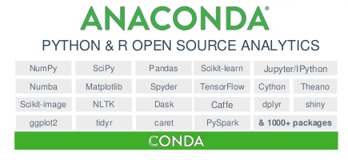
Python overview
Why Anaconda:
Anaconda is a Python distribution that comes preinstalled with lots of useful python libraries for data science.

Slide 14




Python overview
Why Anaconda:
Brings many of the tools used in data science and machine learning with just one install.

Slide 15

Python overview
Why Anaconda:
It was reviewed as the Best Data Science and Machine Learning Platform of 2019

Slide 16
Python overview
There is also Miniconda , which is a smaller sized version of Anaconda.
To begin installation go to:
www.anaconda.com/downloads

Slide 17
Machine Learning with Python
Running Python Code

Slide 18
Running Python Code
There are several ways to run Python code.
First let’s discuss the various options for development environments
There are 3 main types of environments:
Text Editors
Full IDEs (Integrated Development Environment)
Notebook Environments

Slide 19


Running Python Code
Text Editors
General editors for any text file
Work with a variety of file types
Can be customized with plugins and add-on
Keep in mind, most are not designed with only Python in mind.
Most Popular:
Atom
Sublime

Slide 20

Running Python Code
Full IDEs
Development Environments designed specifically for Python.
Larger programs.
Designed specifically for Python, lots of extra functionality.
Most Popular:
Pycharm

Slide 21
Running Python Code
Notebook Environments
Great for learning.
See input and output next to each other.
Support in-line markdown notes, visualizations, videos, and more.
Special file formats that are not .py (.ipynb)
Most Popular:

Slide 22
Running Python Code
Most important note:
Development Environments are a personal choice highly dependent on personal preference.
Choose whichever development environment you prefer!

Slide 23
Running Python Code
Let’s now explore how to run Python code:
First with an editor to create a .py script and run the file at your command line.
Then with a Jupyter Notebook.
First let’s download the text editor:
www.atom.io
Let’s do It!

Slide 24
Machine Learning with Python
Git and GitHub

Slide 25
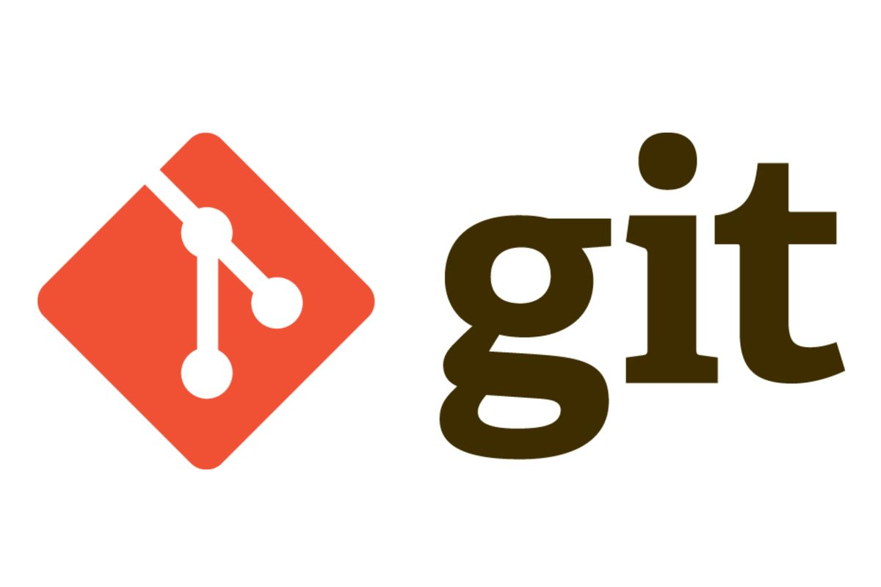
Git and GitHub
What is Git:
By far, the most widely used modern Version Control System (VCS) in the world today.
Git is a mature, source project originally developed in 2005 by Linus Torvalds, the famous creator of the Linux operating system kernel.

Slide 26
Git and GitHub
What is Git:
It’s a command-line tool
Distributed version control for tracking changes in your computer files
Coordinates work between multiple developers
Track who made changes and when
Revert back at any time
Local and remote repos

Slide 27
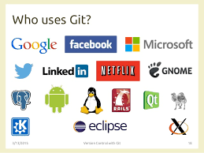
Git and GitHub
Who use Git:

Slide 28
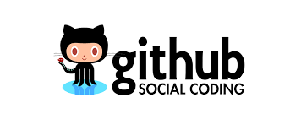
Git and GitHub
What is GitHub:
GitHub is a code Hosting Platform for version control and collaboration. It lets you and others work together on projects from anywhere.

Slide 29
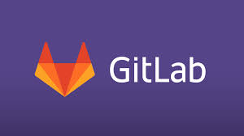
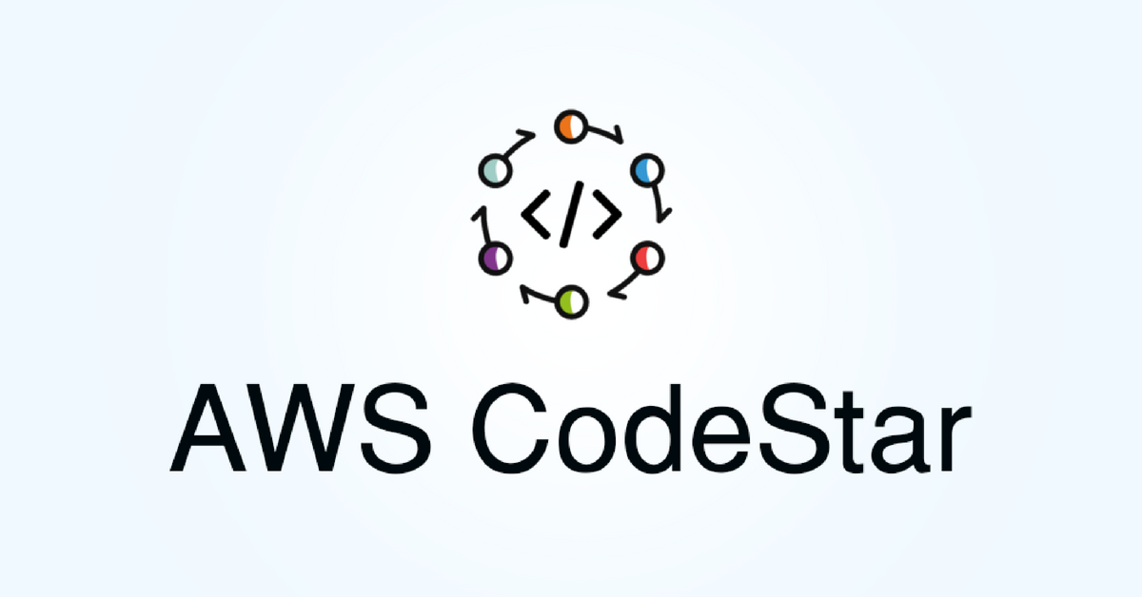


Git and GitHub

Slide 30
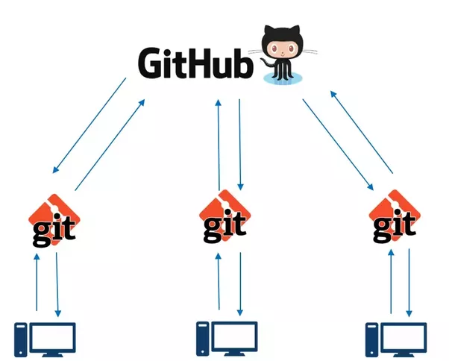
Git and GitHub
Host Platform
Command-line tool

Slide 31



Git and GitHub
Remote Repository
$ git clone
$ git add
$ git commit
$ git push
Working Directory
Staging Area
Local Repository
Edit
$ git pull
git command-line

Slide 32
Git and GitHub
Basic Terminology
Working Directory: Local working place
Staging Area: Also called “Index”, “cache” or “current directory chace”. Is the place where you need to add your files before to commit them.
Local Repository: Is a subdirectory name .git that contains all your necessary repository files. A git repository skeleton.
Remote Repository: Version of your project hosted in the internet (e.g. GitHub) ensuring all your changes are available for other developers.

Slide 33
Machine Learning with Python
Installing Git
For Windows: https://git-scm.com/download/win
For MacOS: https://git-scm.com/download/mac

Slide 34
Installing Git
Installation setup
Keep everything as the default, exception for:
Choose Nano as editor
Adjust your PATH Environment: choose last option, give you more commands
Uncheck “View Release Notes” in the last windows
After the installation:
Open the Git Bash and run the command $ git --version

Slide 35
Installing Git
Bash configuration
The first thing you should do when you install Git is to set your user name and email address.
Execute:
$ git config --global user.name "John Jons"
$ git config --global user.email johnjons@example.com
To check the configuration:
$ git config --list

Slide 36
Git and GitHub
Basic Commands
$ git command --help //Get help for all commands
$ git init <project name> // Create a new local repository
$ git clone <github_url> //Download from existing repo
$ git status //Check the status of working tree
$ git add <file> //Add the changed file (ready to commit) to the Staging Area
$ git add . //Add ALL changed files (ready to commit) to the Staging Area
$ git commit -m “commit message” //Commit all staged files to the Local Repository
$ git push //Push the Local Repository to the Remote Repo
$ git pull //Fetch the latest changes from the Remote Repo (origin) and merge with the Local Repo

Slide 37
Machine Learning with Python
Git and GitHub
hands on
Git Cheet Sheet

